Slide 1
Project POSTBOX
By A Big Zero

Slide 2
A Big Zero
Akash Ahmed – (181 – 15 – 1714)
Mahfuja Ferdousi Mahin – (181 – 15 – 1860)
Abtab Uddin Akib – (181 – 15 – 2000)
Md. Kawser Ahmed Masum – (181 – 15 – 1722)
Rakibul Hassan Raza – (181 – 15 – 2041)
Md. Mosfikur Rahman – (181 – 15 – 2065)
2

Slide 3
Prerequisites
We will do something real big for Project POSTBOX, but for this we have to allow some of prerequisites before. These are –
If gmail account uses 2-step verification, must create an application specific password.
If you aren’t using 2-step verification. You need to be ensure about gmail account is configured to allow less secures apps.

Slide 4
Step – 1
Install Postfix
Let’s update the package database first.
$ sudo apt-get update
Install “mailutils”, which will automatically install postfix
$ sudo apt install -y mailutils

Slide 5
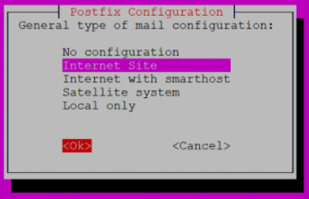
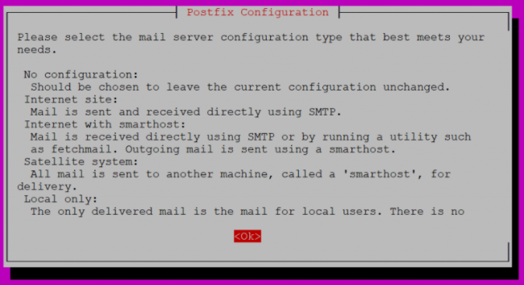
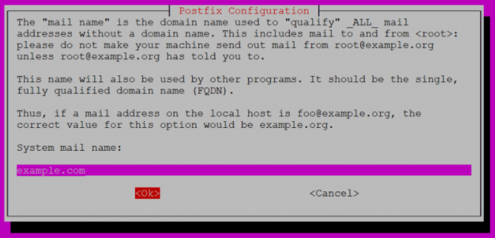
Step – 1
2
1
Follow Instructions by these images.
3

Slide 6
Step – 2
Save file and exit. (Press CTRL + X, press Y and then press ENTER)
Configure Postfix
Edit the Postfix configuration file.
$ sudo nano /etc/postfix/main.cf
Find the following line relayhost = about 6 lines up from the bottom of the file and delete it. Add the following to the end of the file.
relayhost = [smtp.gmail.com]:587
smtp_sasl_auth_enable = yes
smtp_sasl_password_maps = hash:/etc/postfix/sasl_passwd
smtp_sasl_security_options = noanonymous
smtp_tls_CAfile = /etc/postfix/cacert.pem
smtp_use_tls = yes
Save file and exit. (Press CTRL + X, press Y and then press ENTER)

Slide 7
Step – 3
Save file and exit. (Press CTRL + X, press Y and then press ENTER)
Create Password and DB Files
Create the sasl_passwd file which will store our credentials.
$ sudo nano /etc/postfix/sasl_passwd
Insert the following:
[smtp.gmail.com]:587 username@gmail.com:password
Replace username and password with your own.
Save file and exit. (Press CTRL + X, press Y and then press ENTER)

Slide 8
Step – 3
Save file and exit. (Press CTRL + X, press Y and then press ENTER)
Create Password and DB Files
Create a hash database file for Postfix with the postmap command.
$ sudo postmap /etc/postfix/sasl_passwd
There should now be a file called sasl_passwd.db in the /etc/postfix/ directory.
For added security, we will only allow root user to read and write to sasl_passwd and sasl_passwd.db
$ sudo chown root:root /etc/postfix/sasl_passwd /etc/postfix/sasl_passwd.db
$ sudo chmod 0600 /etc/postfix/sasl_passwd /etc/postfix/sasl_passwd.db

Slide 9
Step – 4
Save file and exit. (Press CTRL + X, press Y and then press ENTER)
Sign Certificate
Now we are going to create the certificate.
$ cat /etc/ssl/certs/thawte_Primary_Root_CA.pem | sudo tee -a /etc/postfix/cacert.pem
There should now be a certificate file called cacert.pem in /etc/postfix

Slide 10
Step – 5
Save file and exit. (Press CTRL + X, press Y and then press ENTER)
Send A Test Mail
We’ll now send a test email message. Make sure to replace test@example.com with your own email address.
$ echo "Test Email message body" | mail -s "Email test subject" test@example.com
Don’t forget to check your spam folder.

Slide 11
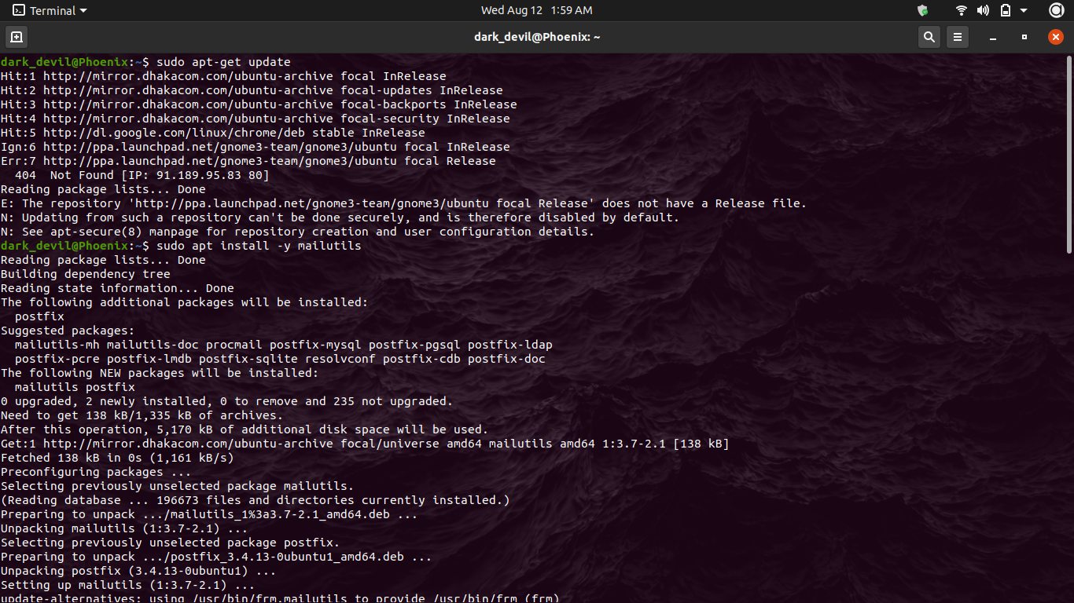
Screenshots
Save file and exit. (Press CTRL + X, press Y and then press ENTER)

Slide 12
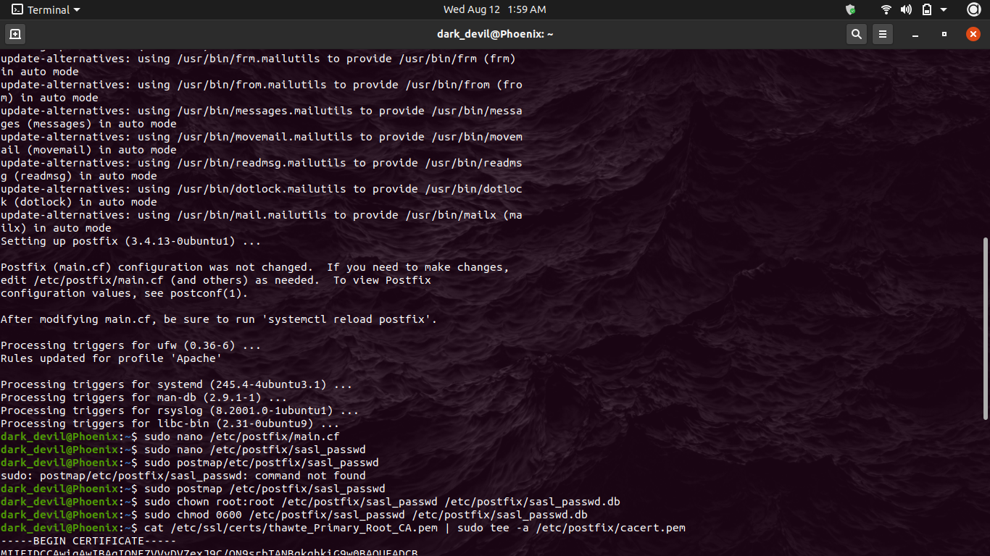
Screenshots
Save file and exit. (Press CTRL + X, press Y and then press ENTER)

Slide 13
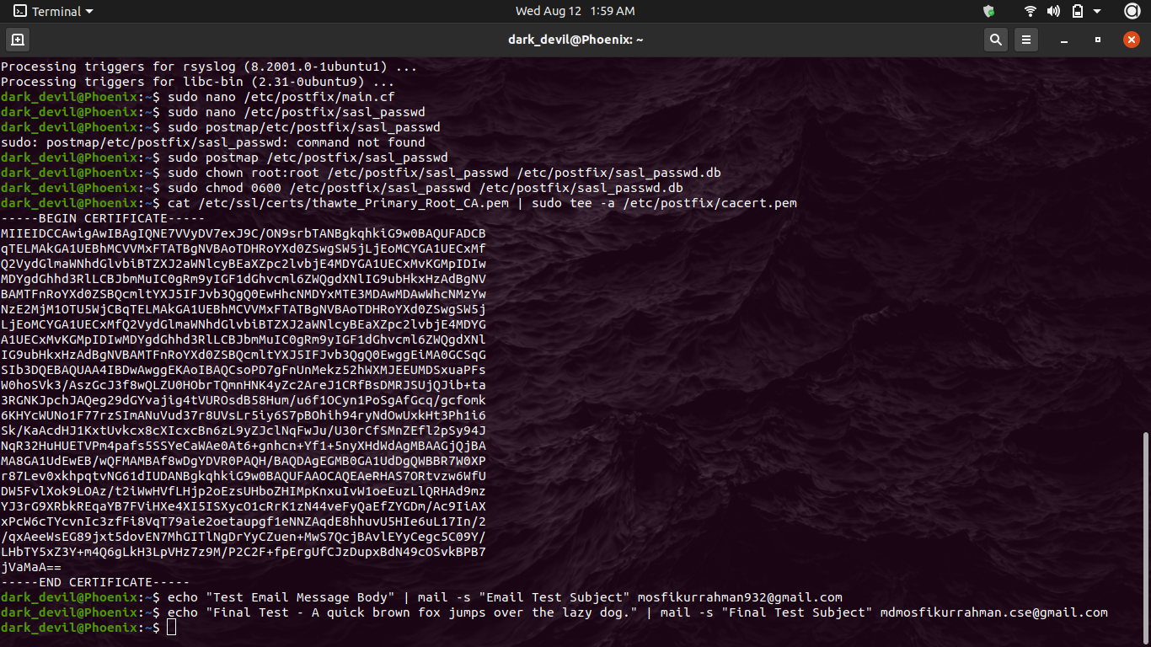
Screenshots
Save file and exit. (Press CTRL + X, press Y and then press ENTER)

Slide 14
Not End Yet!!

Slide 15
Project POSTBOX part -2
By A Big Zero

Slide 16
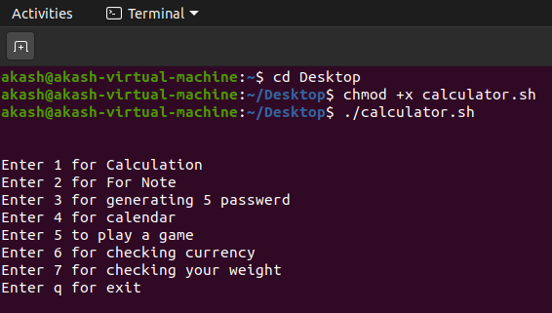
Step – 1 ( compile & Run)
$ cd Desktop
$ chmod +x calculator.sh
$ ./calculator.sh

Slide 17
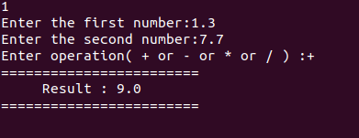
Option-1
Calculation
To calculate any kind of number.
Integer or float.
Addition, subtraction, multiplication,
division operations are done here.

Slide 18
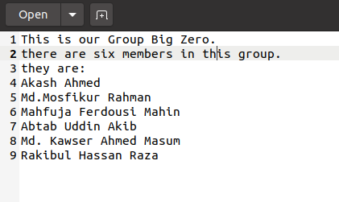
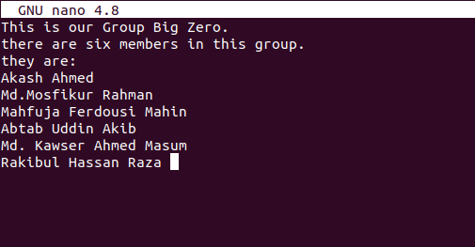
Option-2
For note
Option 2 will open a notepad named
notebook where we can note anything that we want.
^o will save the content.
^x will exit the notepad.

Slide 19
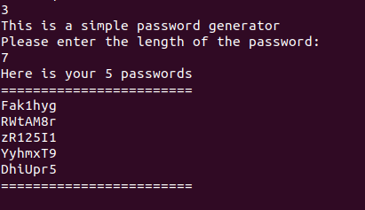
Option-3
Generating Password
Taking the number of characters as input it generates 5 random passwords

Slide 20
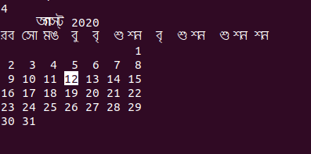
Option-4
Calendar
It will open a calendar. Showing the date.

Slide 21
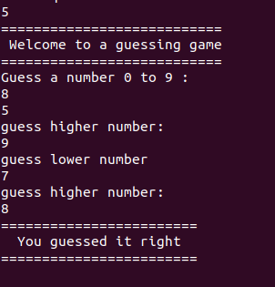
Option-5
Guessing game
The guessing game is a game where we have to guess the number for 0 to 9. If we guessed it wrong and is less then the number it will give us the output to guess higher. And for the grater number it will give the output to guess a lower number. And for the correct guess it will give us a message.

Slide 22
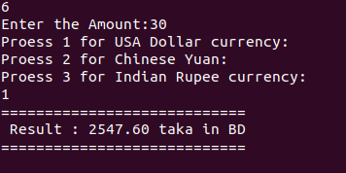
Option-6
Checking currency
The currency changer can change any country’s currency into Bangladeshi currency.

Slide 23
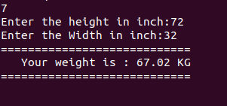
Option-7
Checking your weight
Here it takes the height and the width as inches and convert it into weight using an algorithm.
Width= (height * width * width * 0.6)/660

Slide 24
Elements that are used
Functions
For loop
While loop
Case
If…else
RANDOM function
bc command for arithmetic operation

Slide 25
Source code
Project POSTBOX Github Link:
https://github.com/mdmosfikurrahman/Projects/tree/master/Project%20POSTBOX

Slide 26
THANK YOU!
Stay Home
Stay Safe
Stay Healthy
–
A Big Zero

